Slide 1
Teamwork

Slide 2
What is Teamwork & Team Building
Teamwork
Concept of people working together as a team.
Team player
A team player is someone who is able to get along with their colleagues and work together in a organized group.
Team Building
Process of establishing and developing a greater sense of collaboration and trust between members.

Slide 3
Make a story

Slide 4
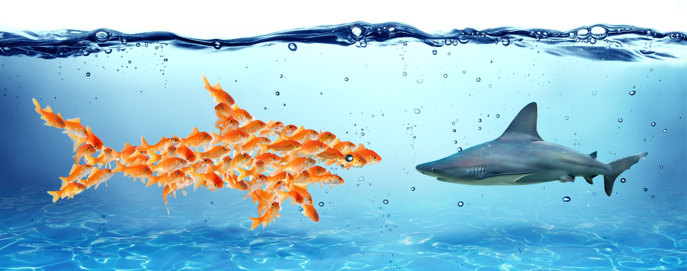
6 Benefits of Teamwork
Fosters Creativity and Learning
Blends Complementary Strengths
Builds Trust
Teaches Conflict Resolution Skills
Promotes a Wider Sense of Ownership
Encourages Healthy Risk-Taking
Notes:
“Two heads are better than one.” We’ve all heard the old adage encouraging teamwork, but what does working together really do for you? Salesmen thrive off healthy competition, but sometimes the use of teamwork in the workplace is a better answer for winning sales. Here are six ways that teamwork benefits you in the workplace.
1. Fosters Creativity and Learning
Creativity thrives when people work together on a team. Brainstorming ideas as a group prevents stale viewpoints that often come out of working solo. Combining unique perspectives from each team member creates more effective selling solutions.
What you have learned from your individual experiences is entirely different from your coworkers. Thus, teamwork also maximizes shared knowledge in the workplace and helps you learn new skills you can use for the rest of your career.
Collaborating on a project creates an enthusiasm for learning that solitary work usually lacks. Being able to share discoveries with the rest of your team excites employees and fosters both individual and team knowledge.
2. Blends Complementary Strengths
Working together lets employees build on the talents of their teammates. While your strength may be creative thinking, a coworker might shine in organization and planning. Do not hesitate to share your abilities with the team.
Often, a team works well together because team members rely on each other to bring individual talents to the table. By observing the process behind these skills, you can learn how to combine your gifts and become a stronger team.
Every time you see your coworkers utilize a different approach in sales, you have a chance to adjust or improve your methods.
3. Builds Trust
Relying on other people builds trust, and teamwork establishes strong relationships with coworkers. Despite occasional disagreements, an effective team enjoys working together and shares a strong bond. When you put your trust in a coworker, you are establishing the foundation of a relationship that can endure minor conflicts.
Trusting your teammates also provides a feeling of safety that allows ideas to emerge. It helps employees open up and encourage each other. Open communication is key when working on a team and produces effective solutions in difficult group projects.
Without trust, a team crumbles and cannot succeed on assigned projects. Great teams build each other up and strengthen individual members to create a cohesive group. By working together, employees learn that wins and losses affect everyone on the team. Teamwork necessitates confidence in each other’s distinct abilities.
4. Teaches Conflict Resolution Skills
Conflicts inevitably happen when you put together a group of unique people. Employees come from varied backgrounds and have different work styles and habits. While these unique viewpoints create the most successful work, they can also generate resentment that quickly turns into conflict.
When conflict arises in teamwork situations, employees are forced to resolve the conflicts themselves instead of turning to management. Learning conflict resolution firsthand is a skill that employees can use to become efficient managers down the road.
5. Promotes a Wider Sense of Ownership
Team projects encourage employees to feel proud of their contributions. Tackling obstacles and creating notable work together makes team members feel fulfilled. Working toward achieving company goals allows employees to feel connected to the company. This builds loyalty, leading to a higher level of job satisfaction among employees.
Teamwork is not just helpful for employees. It benefits the employer in the long run as well. Employees that connect directly with their workplace are more likely to stay with the company. While employees leaving their jobs often cite a lacking salary, another common complaint is that their contributions do not seem to matter. Teamwork allows people to engage with the company and add to the bigger picture.
6. Encourages Healthy Risk-Taking
An employee working on a project alone will probably not want to stick their neck out for an off-the-wall idea. If the project fails when working solo, that employee takes the full brunt of the blame. While you may not get full credit for a successful team project, working with other people spreads out the responsibility for a failed assignment.
Working as a team allows team members to take more risks, as they have the support of the entire group to fall back on in case of failure. Conversely, sharing success as a team is a bonding experience. Once a team succeeds together, their brainstorming sessions will produce revolutionary ideas without hesitation. In many cases, the riskiest idea turns out to be the best idea. Teamwork allows employees the freedom to think outside the box.
There may be no “I” in team, but teamwork can still benefit employees on a personal level. Do not allow competitive natures to get in the way of personal growth in the workplace. Instead, understand how to resolve conflicts and trust teammates to contribute their best ideas. Learn from your team members and build on each other’s skills to create more impressive results in the workplace.

Slide 5
4 Ways to Promote Teamwork Between Employees
Make everyone feel Important
Schedule Team Meetings and Activities
Set Increasingly Difficult Goals
Allow the Team to Solve Big Issues
Notes:
1. Make everyone feel Important
Most managers know that giving an employee direct responsibilities and making them accountable for a particular project’s success is a great way to motivate individual achievement. This, however, also works for teams. Every person on the team should be just as involved as every other member. This can be accomplished through providing all project information, deadlines, and goals to each individual team member. Make each of them feel as if the success of the project is dependent on them and every employee will give it their all.
2. Schedule Team Meetings and Activities
Setting up team meetings and team building exercises is very important in organizations that rely heavily on teamwork. These meetings can be held outside of the office, and can even include a trip out for dinner in which work isn’t discussed until after the meal is finished. There are also several activities that aren’t work related that can help build team unity. These activities can be fun and engaging, and in the end it will help foster an environment of working together to achieve a final goal.
3. Set Increasingly Difficult Goals
A team shouldn’t have to take on the biggest account at the company on the first day that they meet. It is imperative to provide each team with easily achievable goals for their first project. This allows them to feel each other out and develop a group dynamic. Each subsequent goal should be a little more difficult than the last. Great teams can develop out of this tiered type of project assignment.
4. Allow the Team to Solve Big Issues
Managers have an inherent desire to jump in and handle any big issue that arises. This can make a team feel as if they’ve been undercut and aren’t trusted to handle their own jobs. This can detrimentally deplete employee and team morale. If it is possible for a team to handle the issue on their own, then it is imperative to allow them to do so. It isn’t necessary to let a company collapse by not getting involved, but when the team members are capable of handling the issue and a little extra time won’t be detrimental to the organization, then it doesn’t hurt to let them spread their own wings.
A company will never be as successful as it could be if the employees within it do not know how to work as a team. Workers should understand that it is their job to ensure that a business succeeds, and if effectively working in a team is the only way to achieve that goal, then that is what they need to do, regardless of any solitary conditions that they’re used to working in. When a manager knows how to promote proper teamwork within their organization, he ensures that his endeavors will be a success.

Slide 6
Good old lessons on teamwork from an age-old tale
The Tortoise
&
The Hare

Slide 7
Once upon a time a tortoise and a hare had an argument about who was faster.
That’s not true.
The fastest runner is
me!
I’m the fastest
runner.

Slide 8
They decided to settle the argument with a race. They agreed on a route and started off the race.
Fine!
Ok, let’s have
a race.

Slide 9
The hare shot ahead and ran briskly for some time. Then seeing that he was far ahead of the tortoise, he thought he'd sit under a tree for some time and relax before continuing the race.
Poor guy! Even if I take a nap, he could not catch up with me.

Slide 10
He sat under the tree and soon fell asleep.

Slide 11
The tortoise plodding on overtook him and soon finished the race, emerging as the undisputed champ.

Slide 12
The hare woke up and realized that he'd lost the race.

Slide 13
The moral of the story: slow and steady wins the race.
This is the version of the story that we've all grown up with.

Slide 14
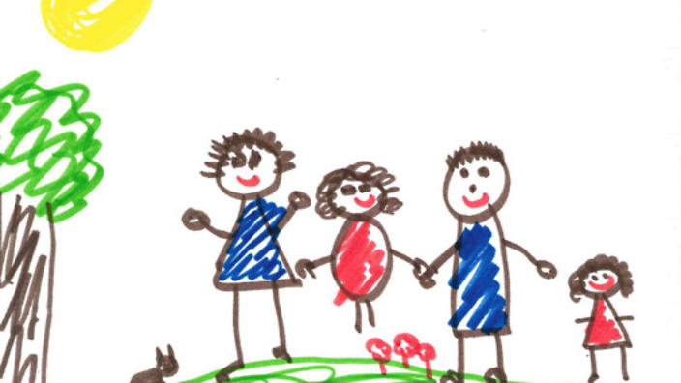
Activity – Who's line is it anyway

Slide 15
But the story continues…

Slide 16
The hare was disappointed at losing the race and he did some soul-searching.
He realized that he'd lost the race only because he had been overconfident, careless and laidback.
If he had not taken things for granted, there's no way the tortoise could have beaten him.
Why did I lose the race?

Slide 17
So he challenged the tortoise to another race. The tortoise agreed.
Okay.
Can we have
another race?

Slide 18
This time, the hare went all out and ran without stopping from start to finish.
He won by several miles.

Slide 19
The moral of the story?
Fast and consistent will always beat the slow and steady. If you have two people in your organization, one slow, disciplined and reliable, and the other fast and still reliable at what he/she does, the fast and reliable employee will consistently climb the organizational ladder faster than the slow, disciplined chap.
It's good to be slow and steady; but it's better to be fast and reliable.

Slide 20
But the story doesn't end here…

Slide 21
The tortoise did some thinking this time, and realized that there's no way he can beat the hare in a race the way it was currently formatted.
How can I can win the hare?

Slide 22
He thought for a while, and then challenged the hare to another race, but on a slightly different route.
The hare agreed.
Can we have another race? This time we’ll go through a different route.
Sure!

Slide 23
They started off. In keeping with his self-made commitment to be consistently fast, the hare took off and ran at top speed until he came to a broad river.
The finishing line was a couple of kilometers on the other side of the river.
Goal

Slide 24
The hare sat there wondering what to do. In the meantime the tortoise trundled along, got into the river, swam to the opposite bank, continued walking and finished the race.
What should I do?

Slide 25
The moral of the story?
First identify your core competency and then change the playing field to suit your core competency.
In an organization, if you are a good speaker, make sure you create opportunities to give presentations that enable the senior management to notice you.
If your strength is analysis, make sure you do some sort of research, make a report and send it upstairs.
Working to your strengths will not only get you noticed, but will also create opportunities for growth and advancement.

Slide 26
The story still hasn't ended…

Slide 27
The hare and the tortoise, by this time, had become pretty good friends and they did some thinking together.
Both realized that the last race could have been run much better.

Slide 28
So they decided to do the last race again, but to run as a team this time.
Hi, buddy. How
about doing our last
race again?
Great! I think we could do it much better, if we two help each other.

Slide 29
They started off, and this time the hare carried the tortoise till the riverbank.

Slide 30
There, the tortoise took over and swam across with the hare on his back.

Slide 31
On the opposite bank, the hare again carried the tortoise and they reached the finishing line together.
They both felt a greater sense of satisfaction than they'd felt earlier.

Slide 32
The moral of the story?
It's good to be individually brilliant and to have strong core competencies; but unless you're able to work in a team and harness each other's core competencies, you'll always perform below par because there will always be situations at which you'll do poorly and someone else does well.
Teamwork is mainly about situational leadership, letting the person with the relevant core competency for a situation take leadership.

Slide 33
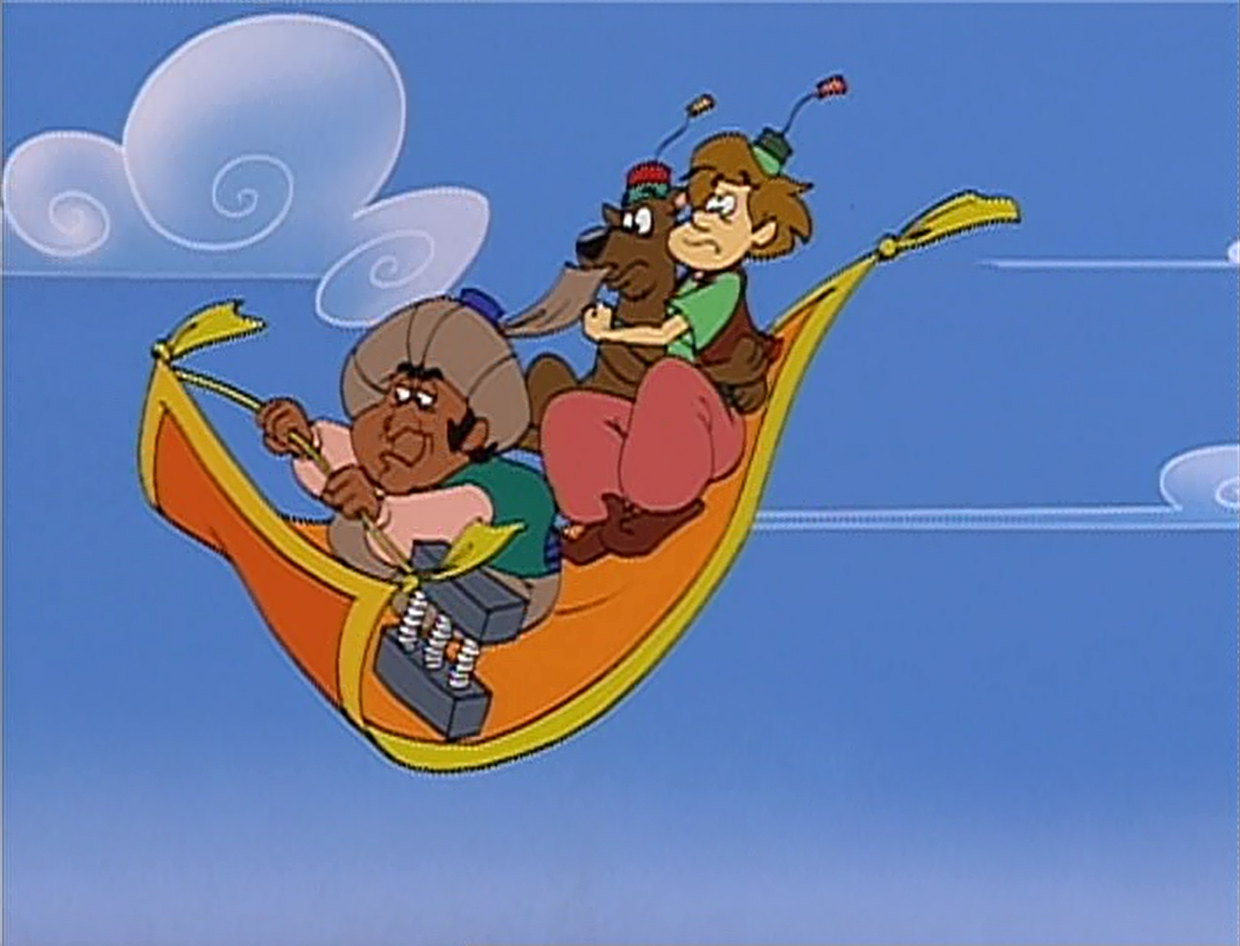
Activity – Flying Carpet
Notes:
Ask 3 people to sit on a carpet [depends on the carpet size], one facing a direction and the other two the other.
Rotate the carpet 180 degrees without touching your hands OR legs on the floor.

